Slide 1
COMP 286 Java II-Data Structures
Chapter 3a
A version of Chapter 3 showing Links As Numbers

Slide 2
A Linked List
Each item points to the next item
  The items are called nodes
One field in the class definition is the name of the class!
  This is the link (a “pointer”) to the next node
  Example code
    class Node
    {
    private T data;
    private Node nextNode;
    }

Slide 3

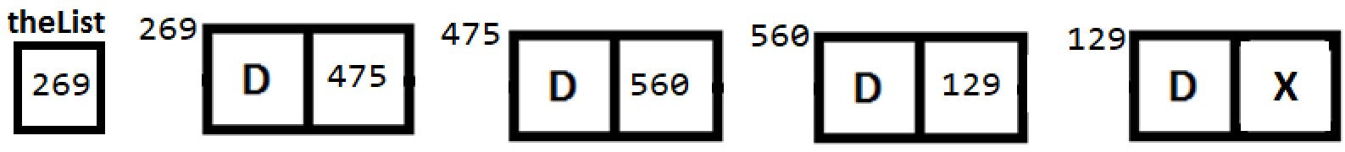
A Picture of a Linked List

Slide 4
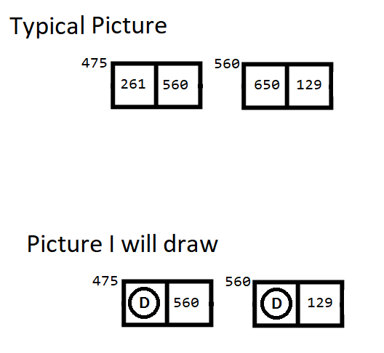
Pictures Aren’t Reality Version 1

Slide 5
Pictures Aren’t Reality! Version 2
There is no such (physical) thing as a linked list in a program
It is an idea
There is one node that is the first node in the list
  That’s the only thing in the program
The next node is linked to it
  The next node is linked to that node, etc.

Slide 6
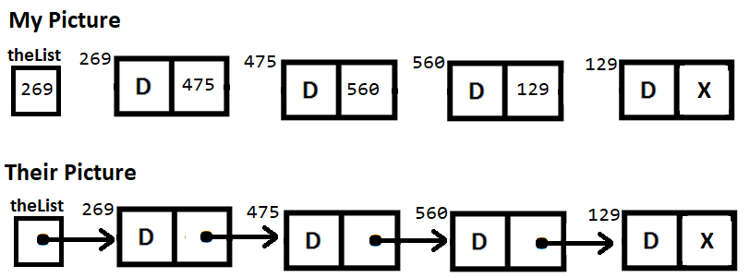
Pictures Aren’t Reality! Version 3
Usually, people draw these pictures a little differently

Slide 7
Methods
The real world item we are modeling is a bag
So, we will use the same methods we did before
Wait! We can reuse the same interface?
ABSOLUTELY!
All we have to do is create new implementation

Slide 8
A Look at the Methods
When we used an array, we added and deleted items from the end of the array
Now, we will add and delete items from the beginning (head) of the list
  Why?
Does it matter?
Let’s look at adding and deleting

Slide 9
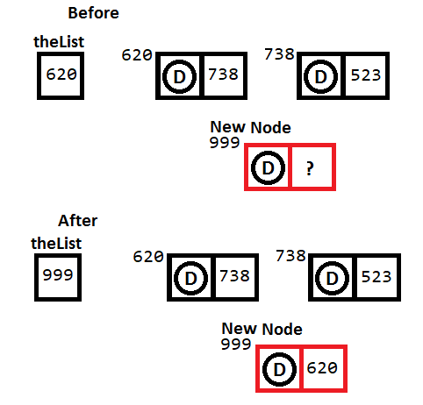
Adding a Node at the Start of the Chain

Slide 10
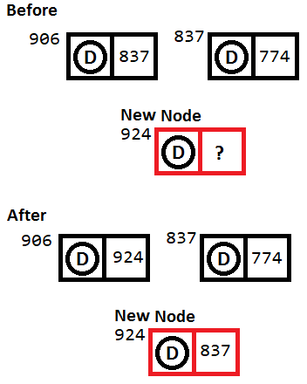
Adding a Node in the Middle of the Chain

Slide 11
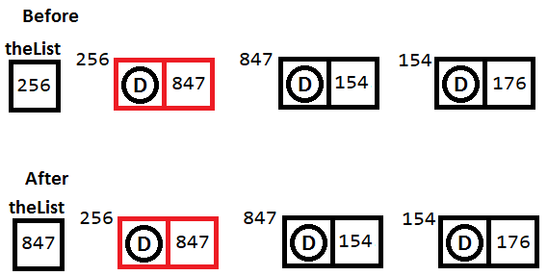
Removing a Node from the Start of the Chain

Slide 12
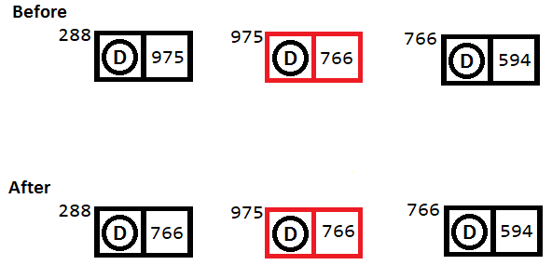
Removing a Node from the Middle of a Chain

Slide 13
A Problem
We have a problem
We want users to be able to access the data in the program, so we consider providing get and set methods for nodes
On the other hand, using a linked list for the bag is a design detail, and the user should not know this

Slide 14
The Solution
The solution is to use nested classes
An important idea to remember is
  The outer class can access data in the inner class directly
  This means the inner class does not need <T>

Slide 15
The Inner Class
(Node)
private class Node
{
private T data;
private Node next;
private Node (T dataPortion)
{
this (dataPortion, null);
}
private Node (T dataPortion, Node nextNode
{
data = dataPortion
next = nextNode;
}
}
} // end LinkedBag

Slide 16
The Class Itself (LinkedBag)
public final class LinkedBag<T> implements BagInterface<T>
{
private Node firstNode;
private int numberOfEntries;
public LinkedBag ()
{
firstNode = null;
numberOfEntries = 0;
}
private class Node
{
… // The inner class (Node)
}
} // end LinkedBag

Slide 17
Adding a Node at the Beginning of the Chain
First, we put data into the node
  Node newNode = new Node (newEntry);
Then, there are two cases
Case 1. The chain is empty
  firstNode = newNode;
Case 2. The chain has nodes in it
  newNode.next = firstNode;
  firstNode = newNode;

Slide 18
Combining the Two Cases
The two cases can be combined by noticing that firstNode is null if there are no nodes in the list
  That makes the line
    newNode.next = firstNode
  work in both cases
So, all we have to code is
  Node newNode = new Node (newEntry);
  newNode.next = firstNode;
  firstNode = newNode;
This will work for both cases

Slide 19
Allocating Memory
When you instantiate a node, we sometimes refer to this as allocating memory
  Actually, instantiating anything allocates memory for it

Slide 20
Traversing a Linked List
Oftentimes, we will need to process every node in the list
  Perhaps we are searching for an item
We use this code
Node currentNode = firstNode;
while (currentNode != null)
{
… // Code to process one node in the list
currentNode = currentNode.next;
} // end while
This code is often referred to as an iterator
You. should memorize this code

Slide 21
A Test Program
We code toArray and isEmpty
  isEmpty is easy
  We code toArray so we can test
    It’s common to have toString as well
See LinkedBagDemo1 for code to test the initial parts of our class

Slide 22
Removing an Unspecified Node
This is easy because we have a linked list
We simply remove the first node in the list
T result = null;
if (firstNode != null)
{
result = firstNode.data;
firstNode = firstNode.next; // Remove first node
numberOfEntries--;
}
return result;

Slide 23
The Rest of the Code
We code the rest of the methods, essentially the same as before

Slide 24
Lab 3-Linked Lists
Create a linked list for shoppers
Put at least 12 patrons in the list
Ask for a person's name
Tell if the person is in the list or not
Data fields are:
  Name
  Shopper ID
  Street
  City
  Zip

Slide 25
Details
For full credit
You must demonstrate the program to the instructor
You must also attach it to Lab 1 in Canvas
You must also turn in a print-out
You must also turn in a design document

Slide 26
Academic Honesty
Again, I remind you of the academic honesty policy for our class
All programs must be written by you alone.
Since this is a class, you may base your programs on programs in the textbook or code from me
Other than that, if a program is not completely your own work, you will receive a zero (0) for it
The phrase “your own work” means
That you wrote the program yourself
That you wrote it without coding help from anyone except me or the textbook
That you did not download the program or any part of it from the internet

